Slide 1
Washington Youth Programs
2025-2026
Department Youth Programs &
Teacher of the Year Contacts
Washington Youth Essay Program
  Grades 3 - 5
  Department Chairman: Carla Scott
    Phone/Text: 509-680-0418
    Email: scottcs1031@gmail.com
Patriots Pen Program
  Grades 6 – 8
  Department Chairman: Carla Scott
    Phone/Text: 509-680-0418
    Email: scottcs1031@gmail.com
Voice of Democracy Program
  Grades 9 – 12
  Department Chairman: Fred Leopold
    Phone/Text: 253-225-5076
    Email: fred.leopold5702@gmail.com
Teacher of the Year
  Elementary, Middle & High School
  Department Chairman: Brandon Pruitt
    Phone/Text: 541-399-5409
    Email: pruett.brandon@yahoo.com

Slide 2

Washington Youth Programs
2025-2026
“How I Respect the American Flag”
Youth Essay Program
  Grades 3-5
  Up to 250 words
  Entries due to Post no later than Oct 31, 2025.
  Program rules and guidance available on Department website on the Washington Youth Essay webpage

Slide 3

Washington Youth Programs
2025-2026
How are You Showing Patriotism
and Support for Our Country
Patriots Pen Program
  Grades 6-8
  300 – 400 words
  Entries due to Posts no later than Oct 31, 2025
  Entries submitted via Scholar’s App.

Slide 4

Washington Youth Programs
2025-2026
How are You Showing Patriotism
and Support for Our Country
Voice of Democracy Program
  Grades 9-12
  3-5 minute audio essay plus transcript
  Entries due to Posts no later than Oct 31, 2025
  Entries submitted via Scholar’s App.

Slide 5
Washington Youth Programs
2025-2026
Check Your Entries
Anonymity
  Must not mention names, schools, cities, age, grades in their essays
Word Count is met for Youth Essay and Patriot Pen and Time Limit is met for Voice of Democracy.
Ensure the Youth Essay forms are COMPLETELY filled out, LEGIBLE, and signed by the parent.

Slide 6
Washington Youth Programs
2025-2026
Scholar’s App
Post & District access granted by Department. Email sent a few months ago.
Flyers with separate QR Codes for Patriots Pen and Voice of Democracy available this year.
  Flyers can only be created at the Post level
All Training Videos and Guides can be found on the Resourses page of the Department Website.

Slide 7
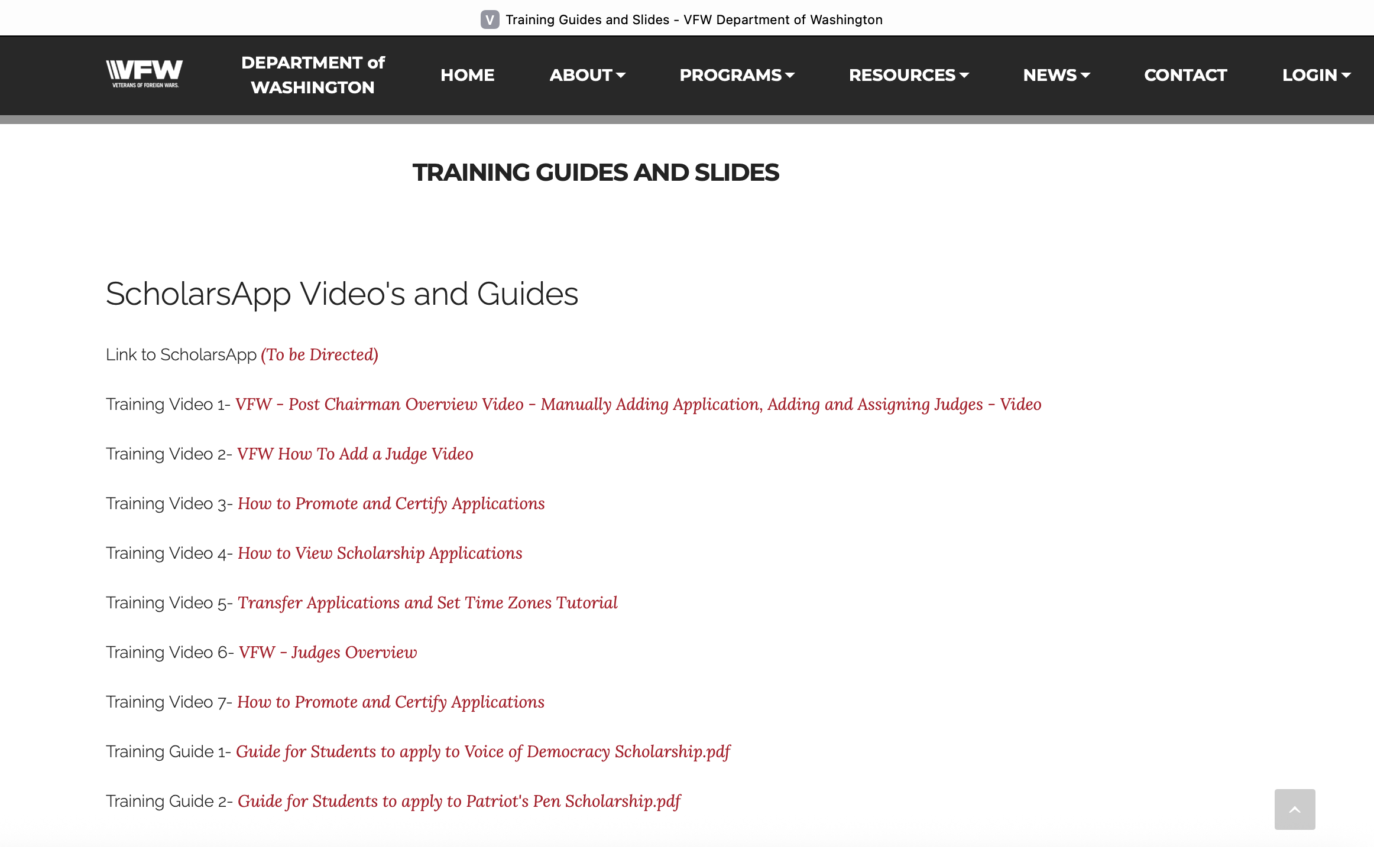
Washington Youth Programs
2025-2026
Training Guides & Slides
Scholars App Training Videos for Posts and District Chairmen
Training Guides for Students

Slide 8
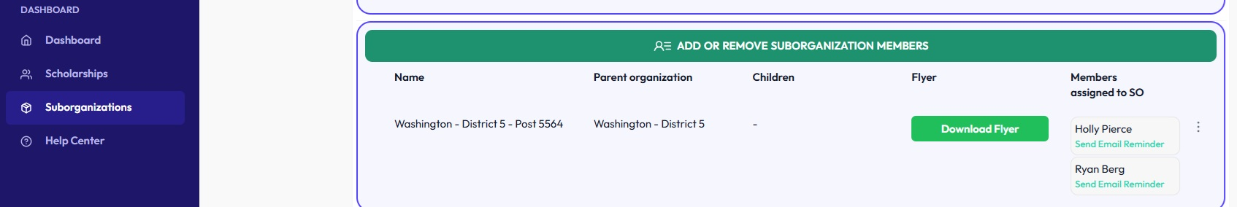
Washington Youth Programs
2025-2026
How to Create the Flyers on Scholar’s App
Log Into Scholar’s App
Click on Suborganizations
Click on Download Flyer
Only available for Posts – not Districts

Slide 9
Washington Youth Programs
2025-2026
How Many Entries Are Advanced?
Youth Essay
Patriots Pen
Voice of Democracy
  1 winner for every 15 entries in EACH grade are sent to District
  1 winner for each grade is sent to Department
  1 winner for every 15 entries are sent to District (all grades combined)
  1 winner is sent to Department
  1 winner for every 15 entries are sent to District (all grades combined)
  1 winner is sent to Department

Slide 10
Washington Teacher of the Year
2025-2026
Teacher of the Year Program Guidelines
Make sure your Teacher is from Washington State
Application can be found on the Department Website under Programs
Minimum requirements are a 1-page resume and a head & shoulder photo
Maximum of 5 pages of documentation such as letters of recommendation, newspaper article, references, etc.
Posts may submit one (1) from each level (Elementary, Middle, High School) to move from Post to District. District will submit one (1) from each level to move to state.
Deadlines are the same as the Youth Program deadlines.

Slide 11
Washington Youth Programs
2025-2026
Deadlines to Remember
Youth Essay, Patriots Pen, VOD, Teacher of the Year
OCTOBER 31 – All entries due to Posts
NOVEMBER 15 – Post winners due to District
DECEMBER 15 – District winners due to Department
  Note: It is preferred to have District Youth Essay winners scanned and submitted to the Department Chairman via email instead of mailing.

Slide 12
Washington Youth Programs
2025-2026
Questions

